Slide 1
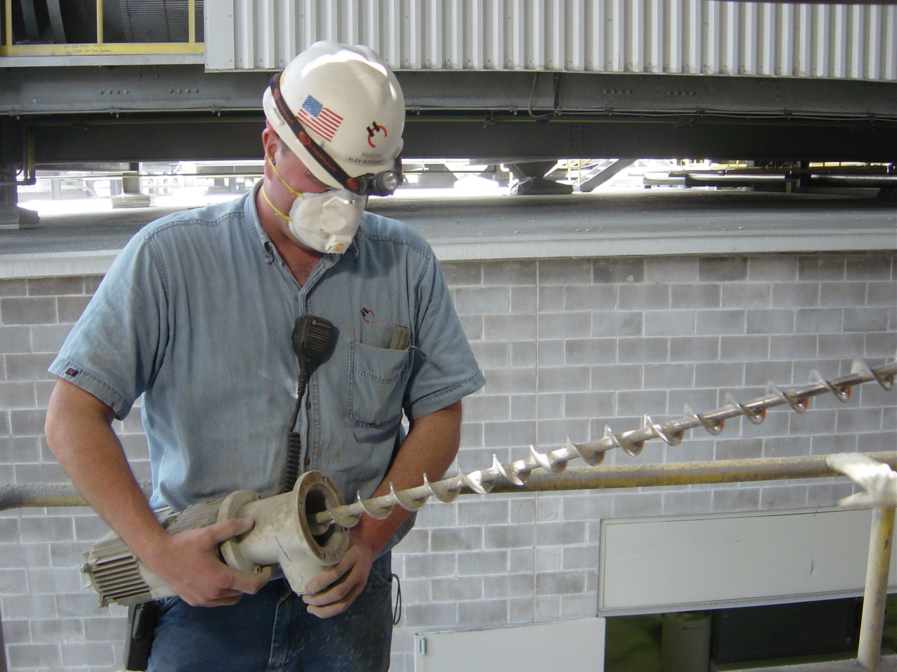
Practical Aspects of Sampling
PPE Course

Slide 2
Objectives
Understand the difference between systematic and random errors
Be aware of the three golden rules of sampling
Know the sampling points along the process
Be able to provide recommendations for proper sampling points and equipment

Slide 3
Agenda
Introduction
4
Sampling points along the process
9
Sampling of coarse bulk material
12
Sampling of fine material (powder)
24
Summary
39
Annex
41

Slide 4
Introduction

Slide 5
Sampling forms the basis for process control
Sample
s₁
Effect
Preparation
s₂
Action
Analysis
Decision
s₃
Result
Interpretation
Typically: s₁ >> s₂ > s₃
5

Slide 6
There are two basic error types with sampling
Systematic Errors
Random Errors
Biased samples
Deviation to the real value can not be calculated
Unbiased samples
Deviation to the real value can be calculated with statistics
Not Representative
Not all particles have the same chance to enter the sample.
Representative!
Random errors:
- Error of analysis: s_{A}²
- Fundamental error: s_{ST}²
- Error of variability: s_{S}²
[ Systematic errors can not be quantified. They can be detected by cross-checks with alternative procedures.]
6

Slide 7
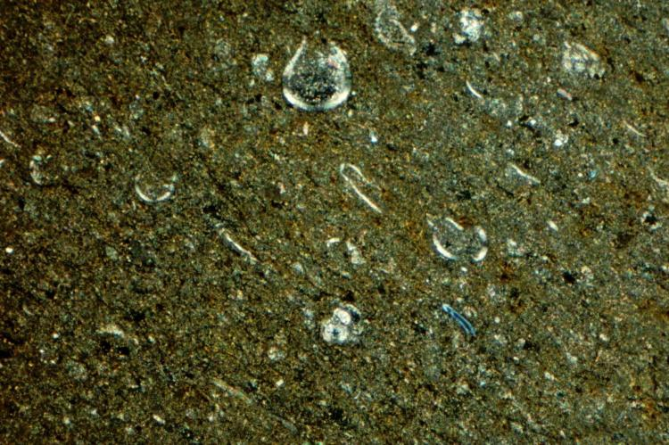
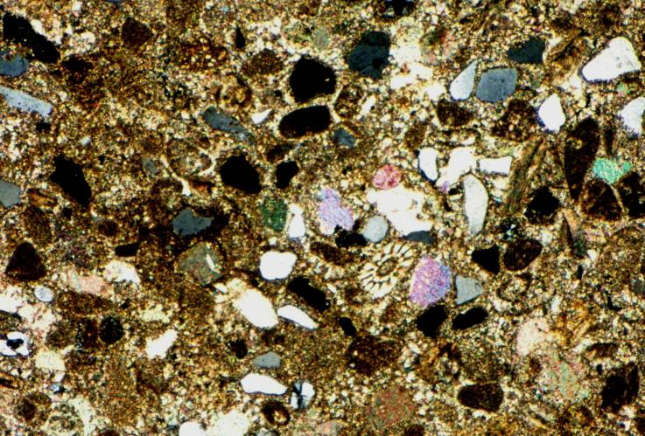
Illustration: Compositional heterogeneity
Thin sections of marly-type limestone (same magnification)
Smaller s²(c)
Larger s²(c)
The composition variance s²(c) is sometimes also called ‘small scale heterogeneity’, denoted as I [kg%²].
7

Slide 8
How to obtain bias free samples
The three golden rules of sampling
Always sample on a falling stream
Sample the whole cross-section of the stream
Combine single samples into a composite sample (rule of thumb: 15 single samples into one composite)
Easy in theory – hard to achieve in practice.
All particles in the stream must have the same probability to enter the sample.
8

Slide 9
Sampling points along the process

Slide 10
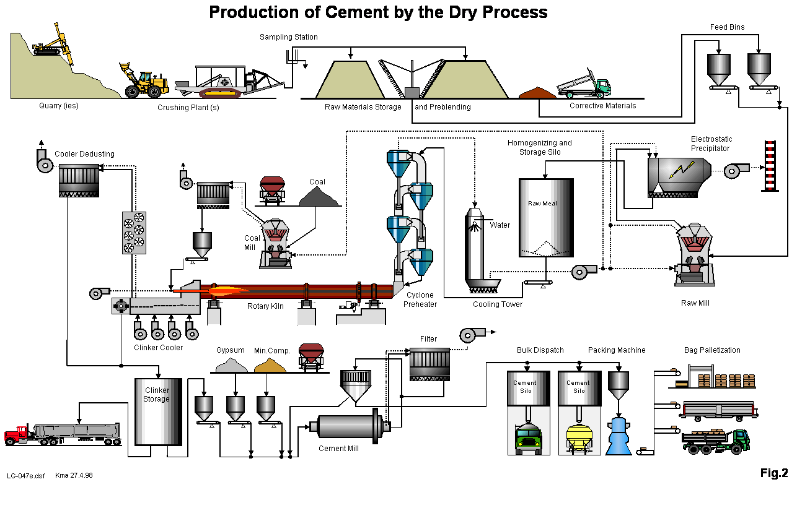
Sampling points along the process
2
1
3
5
7
4b
4a
6
8
9
10
11
10

Slide 11
We’ll group the materials into two classes
Coarse Materials
Powdered Materials
1
Drill hole chips
Pre Mix (stockpile)
Correctives
Raw mix
Clinker
Additives
4b
Raw meal
Kiln feed
Hot meal
Fine coal
Cement, ex mill
Cement, dispatch
2
5
3
6
4a
7
8
10
9
11
11

Slide 12
Sampling of coarse bulk material

Slide 13
Premix after crusher
Objective
Chemical composition of pre-mix Adjusting materials fed to the crusher Control stockpile composition
Material
Mix of: limestone, marl, clay
Mode
Semi-automatic, automatic
Type
Composite and/or spot
PGNA is state of the art technique for premix control
Frequency
e.g. once per hour
Location
Conveyor belt after crusher
Quantity
100 kg and more
Equipment
Hammer, spoon sampler or Sampling tower
Transport
Manual

Slide 14
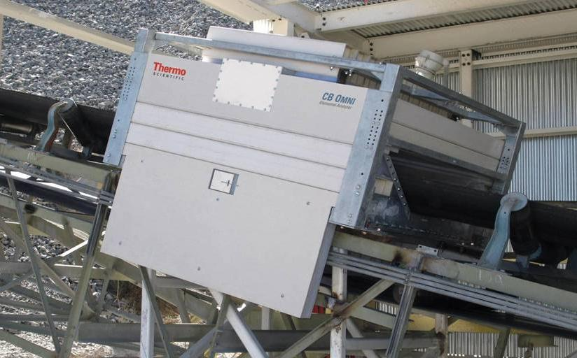
PGNAA*, standard solution for in-line analysis of bulk material on belt conveyor
* Prompt Gamma Neutron Activation Analyzer
14

Slide 15
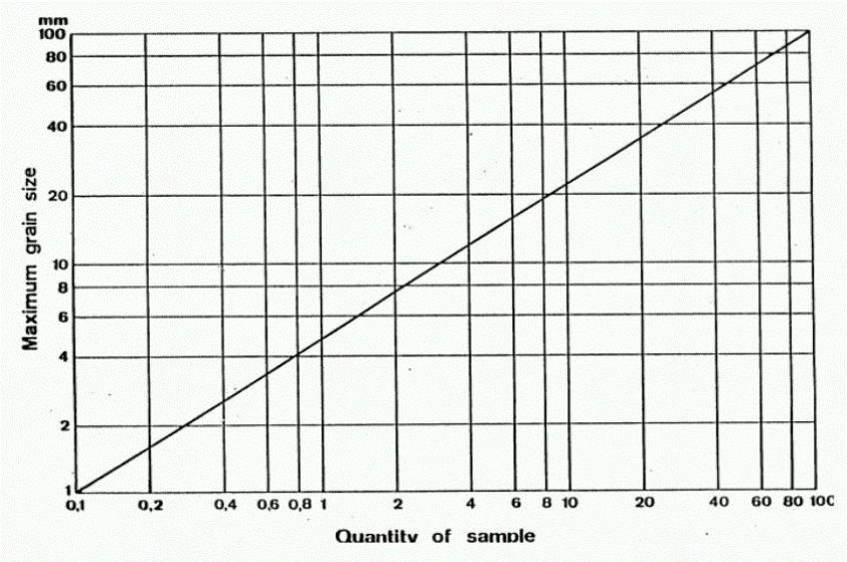
Coarse bulk material – sample quantity vs. top particle size
e.g. crushed limestone
e.g. Iron ore
ca.
1kg
ca.
70kg
kg
15

Slide 16
Avoid sampling from running conveyor belt
Manual sampling from a running conveyor belt
Is a safety hazard
Does not provide a meaningful sample for process control
16

Slide 17
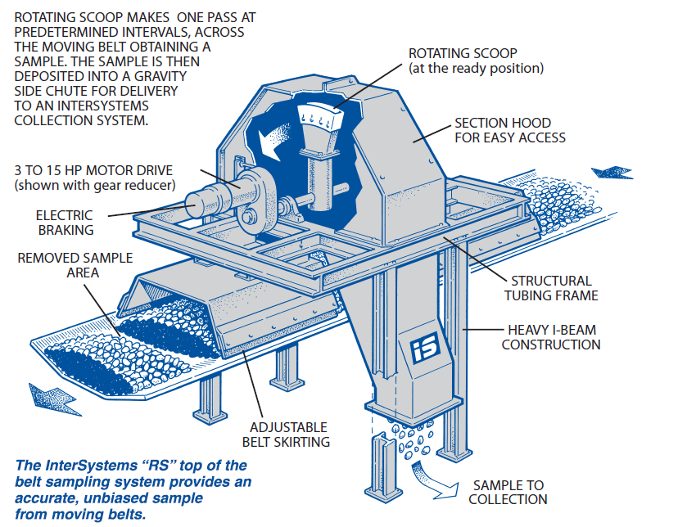
Rotating scoop (hammer) sampler – not suitable for routine control
Design: Distance between side plates of hammer > 3 * top size of material
Rotating velocity (bouncing of coarse particles)
Biased if height/shape not properly adjusted
17

Slide 18
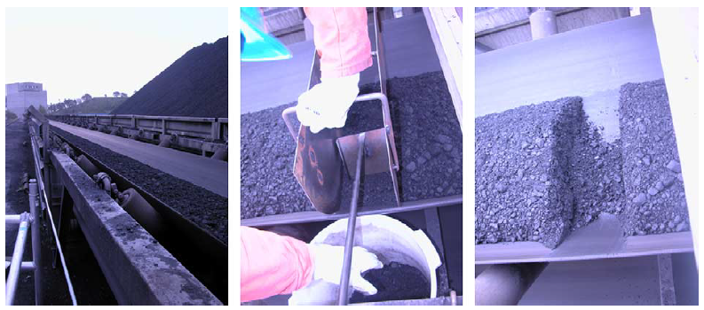
Stopped belt sampling – not suitable for routine control
Use of sampler cutter. In principle correct, if all material is removed. Sometimes applied for PGNAA calibration.
Disadvantages: Production stop, not practical for > 20 samples (belt drive), not working at inclined belts.
18

Slide 19
Clinker sampling
Objective
Ensure correct burning regime by measuring chemical composition and free lime
Material
Clinker
Mode
Manual/semi automated/automated
Type
Spot sample / composite sample
Frequency
~ once per hour (min every 4 hours)
Location
Transfer points/transport after cooler, drilled cooler plate
Quantity
2 – 5 kg / sample
Equipment
Piston, scoop sampler
Transport
Manual or pneumatic (needs on-site sample preparation)

Slide 20
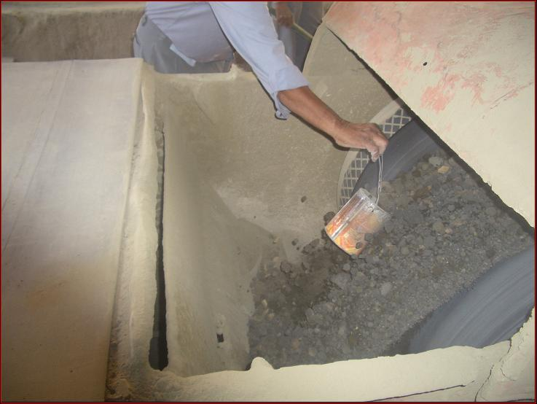
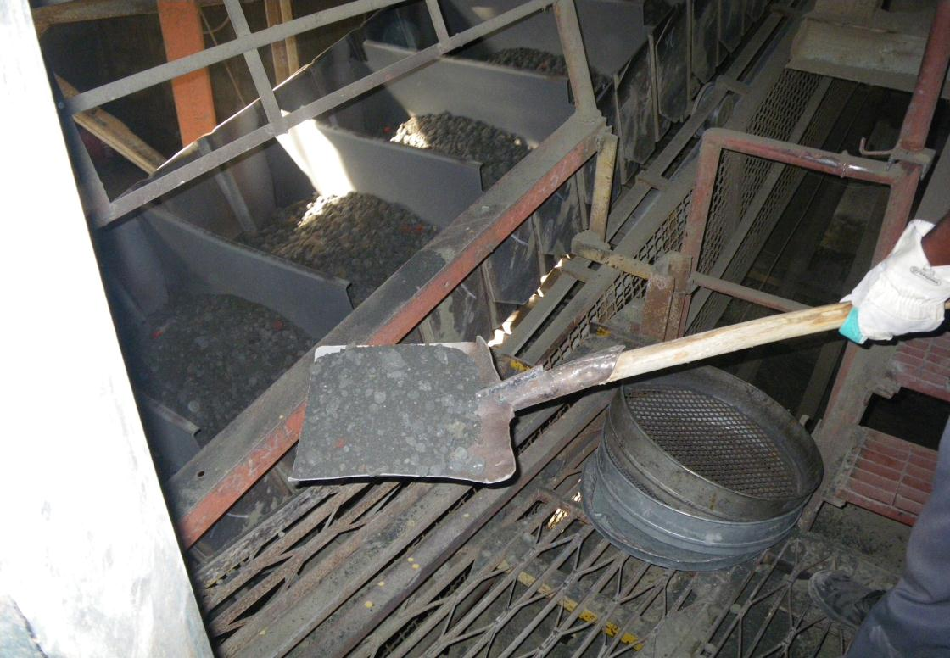
Manual sampling – not recommended
Safety issue
Representativity not given
20

Slide 21
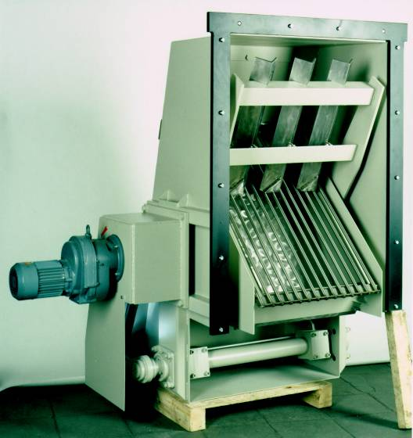
Clinker sampler (spoon sampler): Preferred solution
Installation: free falling material stream
Sampling point: material chute
Sampling type: spot sampling
Sample material: coarse, clinker
Particle size: max. 100 mm
Temperature: max. 250 °C
Sample quantity: app. 15 dm³/pass
Sample cycles: < 20 cycles / h
Sampler weight: up to 550 kg
21

Slide 22
Clinker sampler with downstream sample preparation
Clinker transport
Spoon sampler
Vibration feeder
Crusher
Sample splitter
Fine grinding mill
Mixer
Dosing unit
Pneumatic tube
sending station
Collection cup
Automatic sieve
Measuring cup with leveling and balance
22

Slide 23
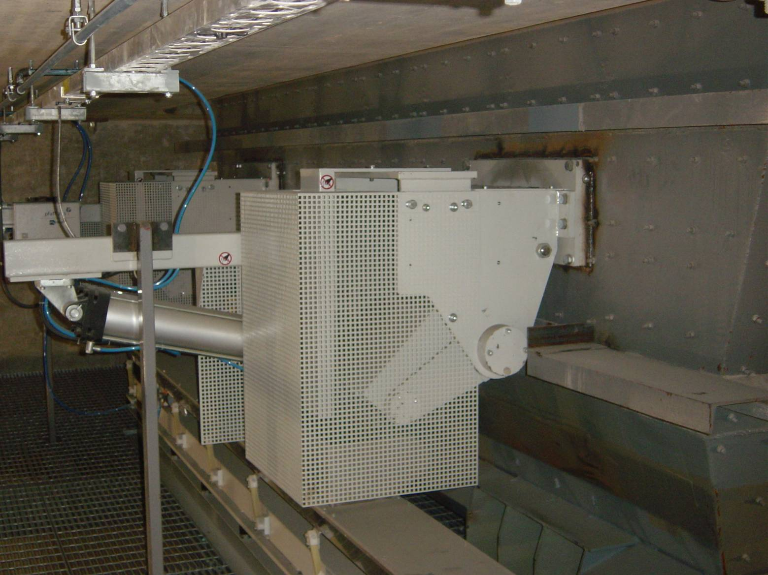
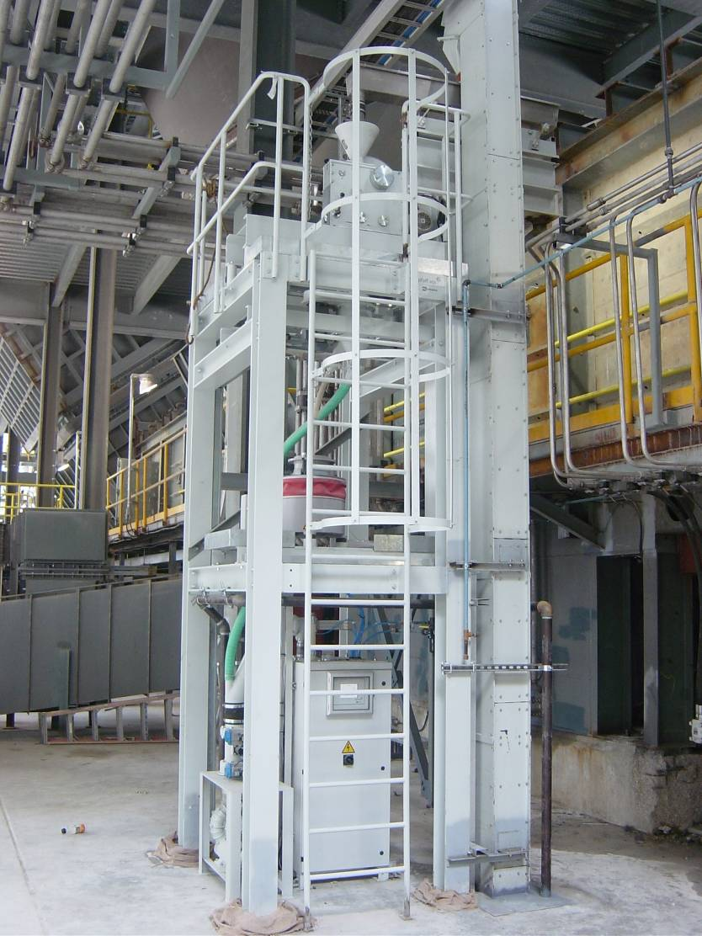
Automated clinker sampling: Example
23

Slide 24
Sampling of fine material (powder)

Slide 25
Raw meal sampling
Objective
Chemical analysis for raw mix and feeder control
Sieve or PSD analysis for separator adjustment
Material
Raw meal, finish product
Mode
semi automated/automated
Type
Composite sample
Frequency
Hourly or 2-hourly
Location
After raw mill cyclone before homo silo. Bag-house dust added.
Quantity
2 – 5 kg / sample
Equipment
Screw sampler. (Air slide sampler: not optimal)
Transport
Manual, pneumatic tube system (preferred)

Slide 26
Kiln feed sampling
Objective
Monitoring of feed uniformity (chemistry and fineness)
Material
Kiln feed
Mode
semi automated/automated
Type
Composite sample (option for spot)
Frequency
Every 2-4h
Location
Transfer behind homo silo to feed system, after last material added (e.g. kiln dust)
Quantity
2 – 5 kg / sample
Equipment
Screw sampler. (Air slide sampler: not optimal)
Transport
Manual or pneumatic tube system

Slide 27
Cement (ex mill) sampling
Objective
Control of feed system and separator adjustment (chemistry and fineness) Monitor physical properties
Material
Cement
Mode
semi automated/automated
Type
Composite sample (spot sample)
Frequency
Hourly or 2-hourly
Location
Behind mill, transport to storage silo
Quantity
2 – 5 kg / sample
Equipment
Screw sampler. (Air slide sampler: not optimal)
Transport
Manual, pneumatic tube system (preferred)

Slide 28
General remarks on sampling of powdered materials
Recommended sampling system:
Automated screw sampler including mixer, splitter and excess return. Sampler must allow programming of extraction sequences.
Pay attention to
Appropriate position (across material flow)
Distance to transfer points (e.g. dust return) and de-dusting systems
Pressure situation (no draft through the sampling system)
Drop height of sample (< 10 m)
Protection and maintenance of sampler (avoid exposure moisture)
Sampler accessibility
28

Slide 29
Screw sampler installation: Always across material flow
29

Slide 30
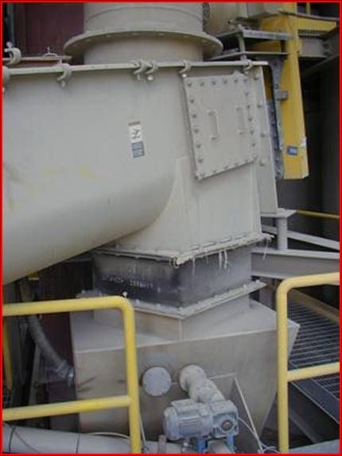
Raw meal
Filter dust
Comments on the sampling point:
Incorrect direction of screw
Too close to mixing point
Search for alternative lower in the chute
Raw mill product
30

Slide 31
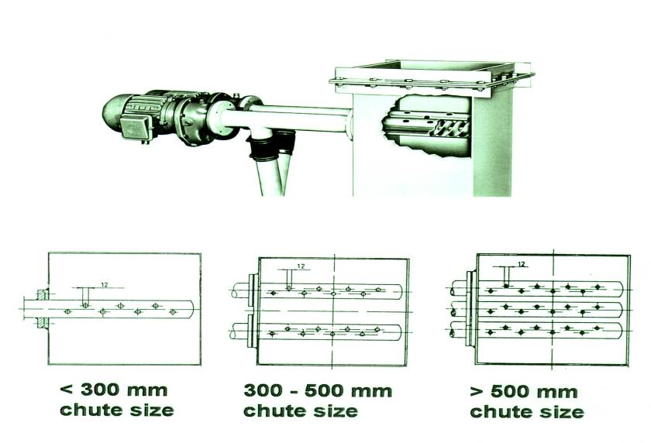
Screw sampler: Standard solution for powders
31

Slide 32
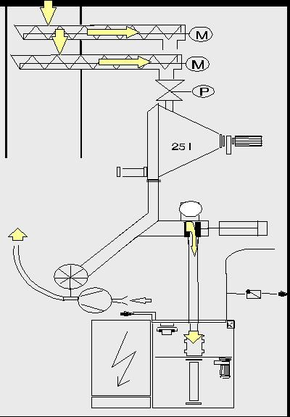
Automated screw sampler with mixer, splitter and sending station
Double screw sampler
Shut off valve
Mixer
Dosing unit
Material return
Pneumatic tube sending station
32

Slide 33
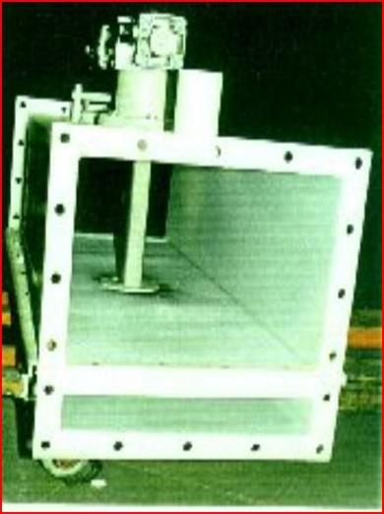
Air slide sampler
Air slide samplers should only be installed if there is no room for screw samplers (consider transfer chute between two air slides).
Continuous or spot sample
Material: powdered, not sticky
Max particle size: 2 mm
Max. temperature: 120 °C
Sample quantity: up to 22 kg/h
Cycles: < 30/h
33

Slide 34
Air slide sampler
What is the correct position for an air slide sampler?
Material flow
34

Slide 35
Hot meal sampling
Objective
Measure Cl, SO₃, Alkalis and LOI to control the degree of calcination and as indicator for build-up formations
Material
Calcinated meal
Mode
manual/automated
Type
Spot sample
Frequency
Once every 4 hours / on demand
Location
Outlet bottom cyclone towards kiln inlet
Quantity
Approx. 1 kg
Equipment
scoop / piston sampler
Transport
Manual / pneumatic tube system

Slide 36
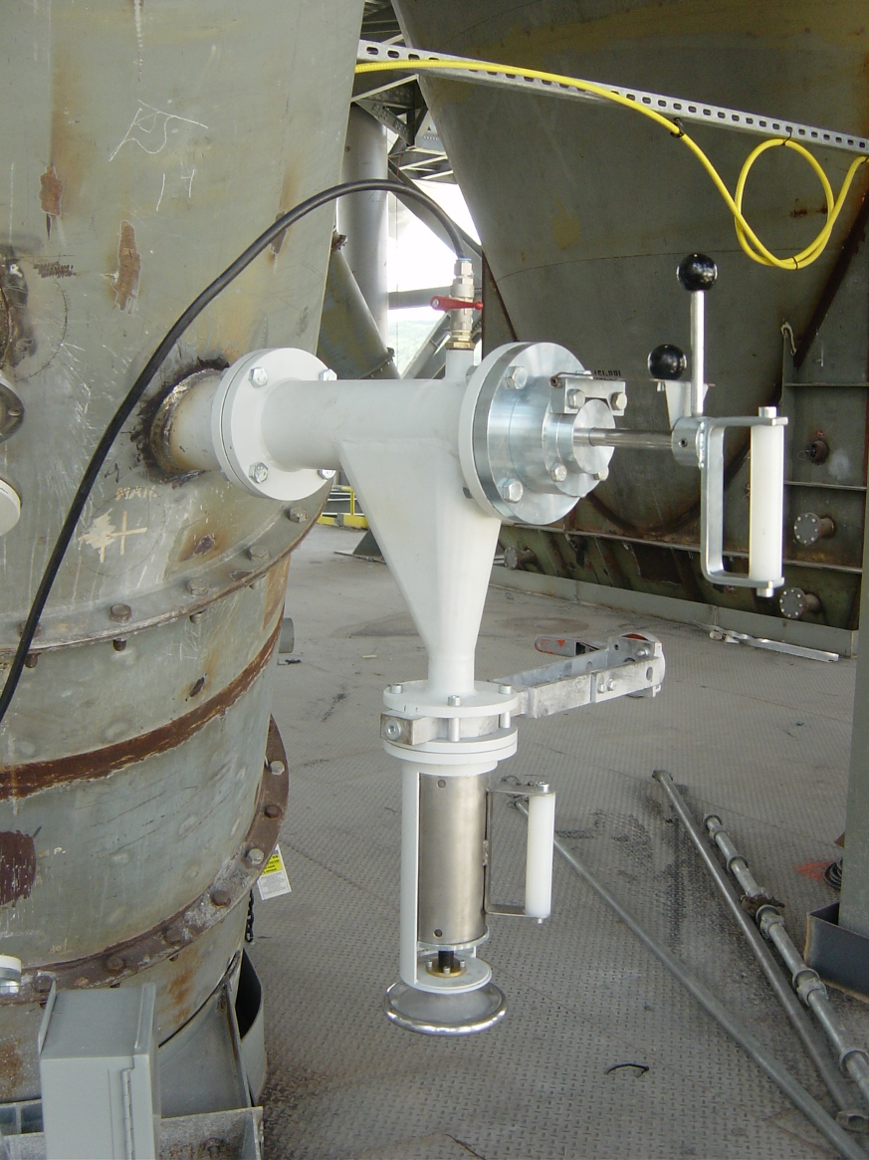
Hot meal sampling
Hot meal sampling is potentially dangerous (raw meal flushes).
Direct contact with hot meal must be avoided.
Safe manual and automated sampler are available.
FLS design
Lit: ZKG International, 2003, 56, 34
36

Slide 37
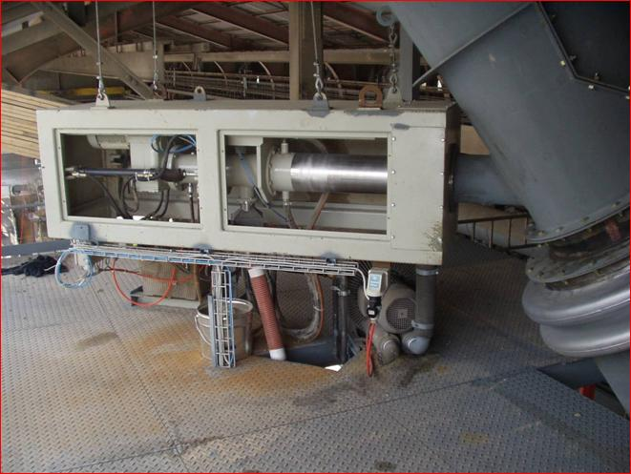
Automated hot meal sampling
Example: SG (CH)
Water cooling
Costs: 70 k€
37

Slide 38
Summary of recommended sampling devices according to the material type
38

Slide 39
Summary

Slide 40
Summary
Sampling of coarse bulk material for process control is not practicable with the available resources (time/manpower). If required for special tests, large sample masses (> 500 kg) and high preparation effort can be expected.
Every sampling procedure has errors. Representativeness of a sample needs to be evaluated with respect to the required accuracy.
Adequate sampling installations in cement plants need to be integrated during design of the plant. Good sampling installations need space.
40

Slide 41
Annex

Slide 42
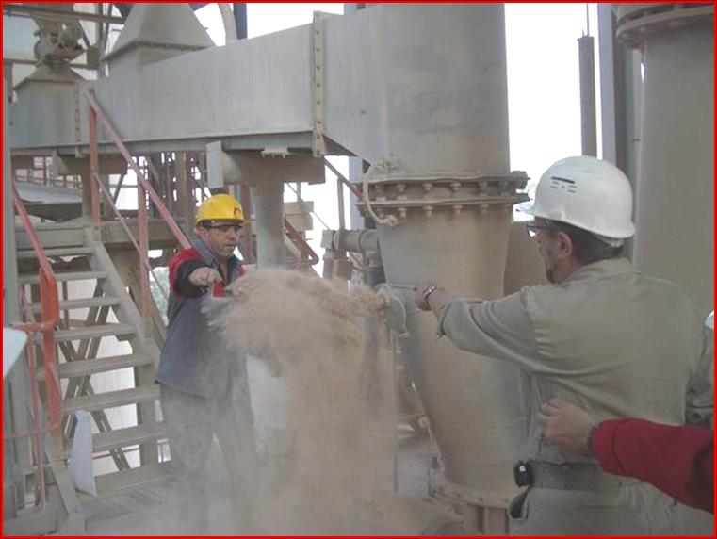
Raw meal sampling: Suggest improvements
42

Slide 43
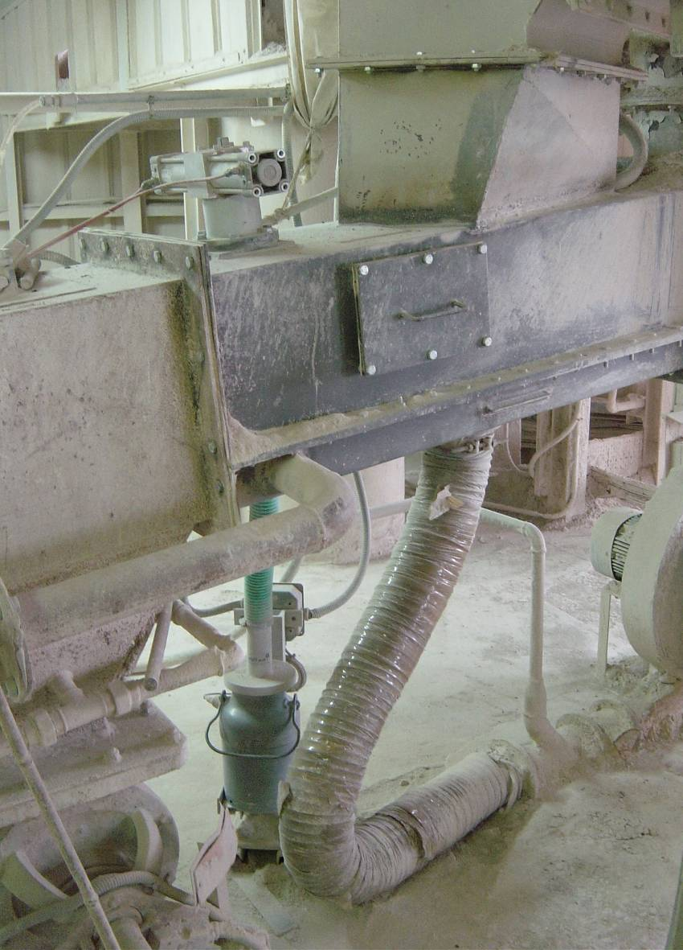
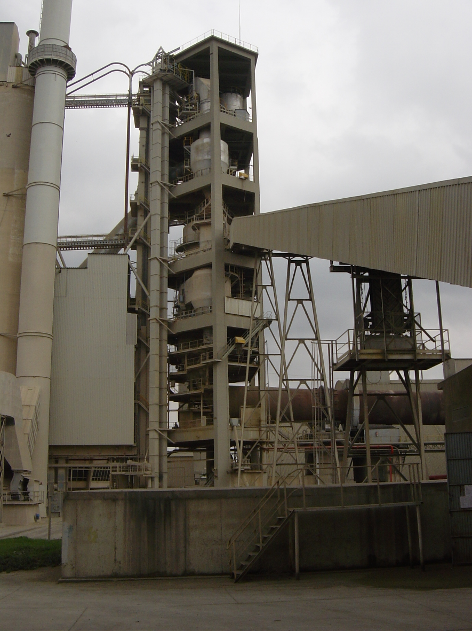
Raw meal sampling: Suggest improvements
Sampler is located here
43

Slide 44
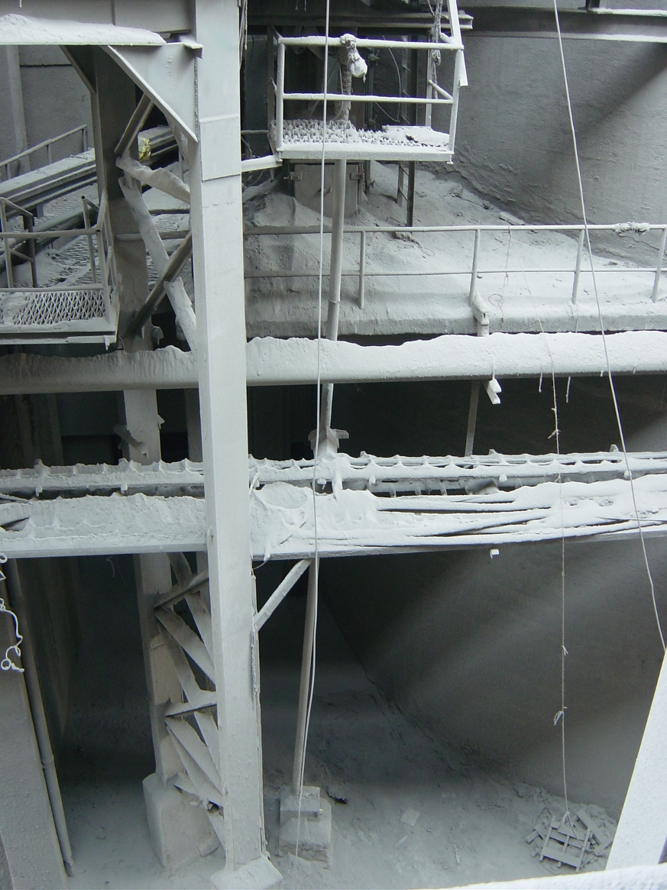
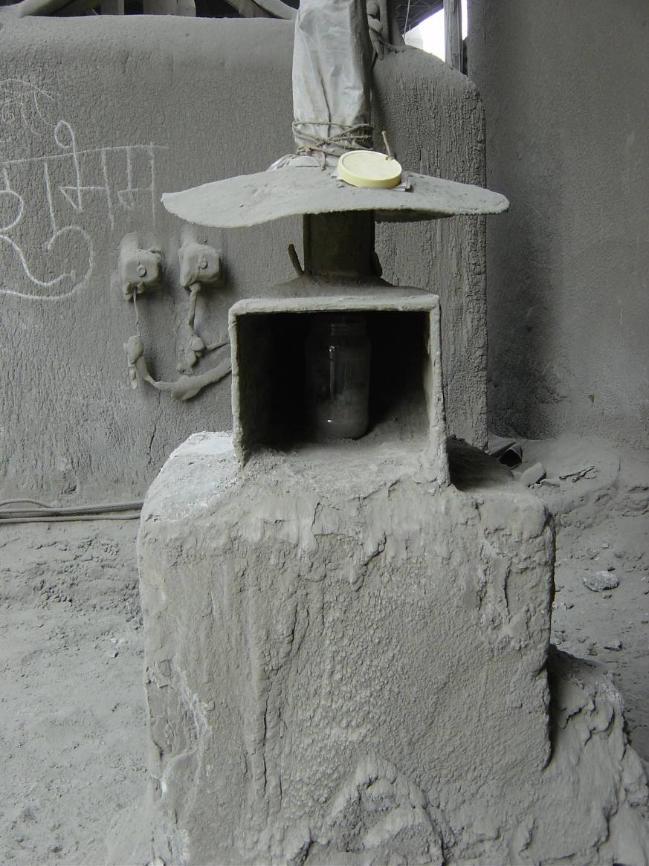
Cement sampling: Suggest improvements
Sampler
Sample container
2015-08-04
44

Slide 45
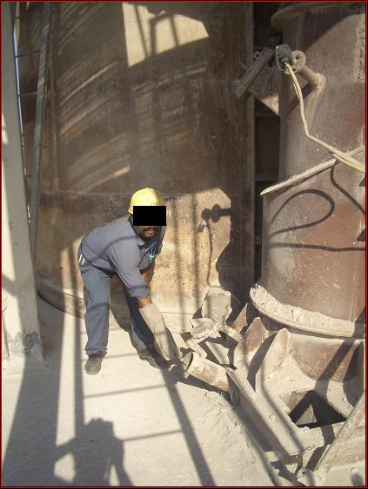
Hot meal sampling: Suggest improvements
45

Slide 46
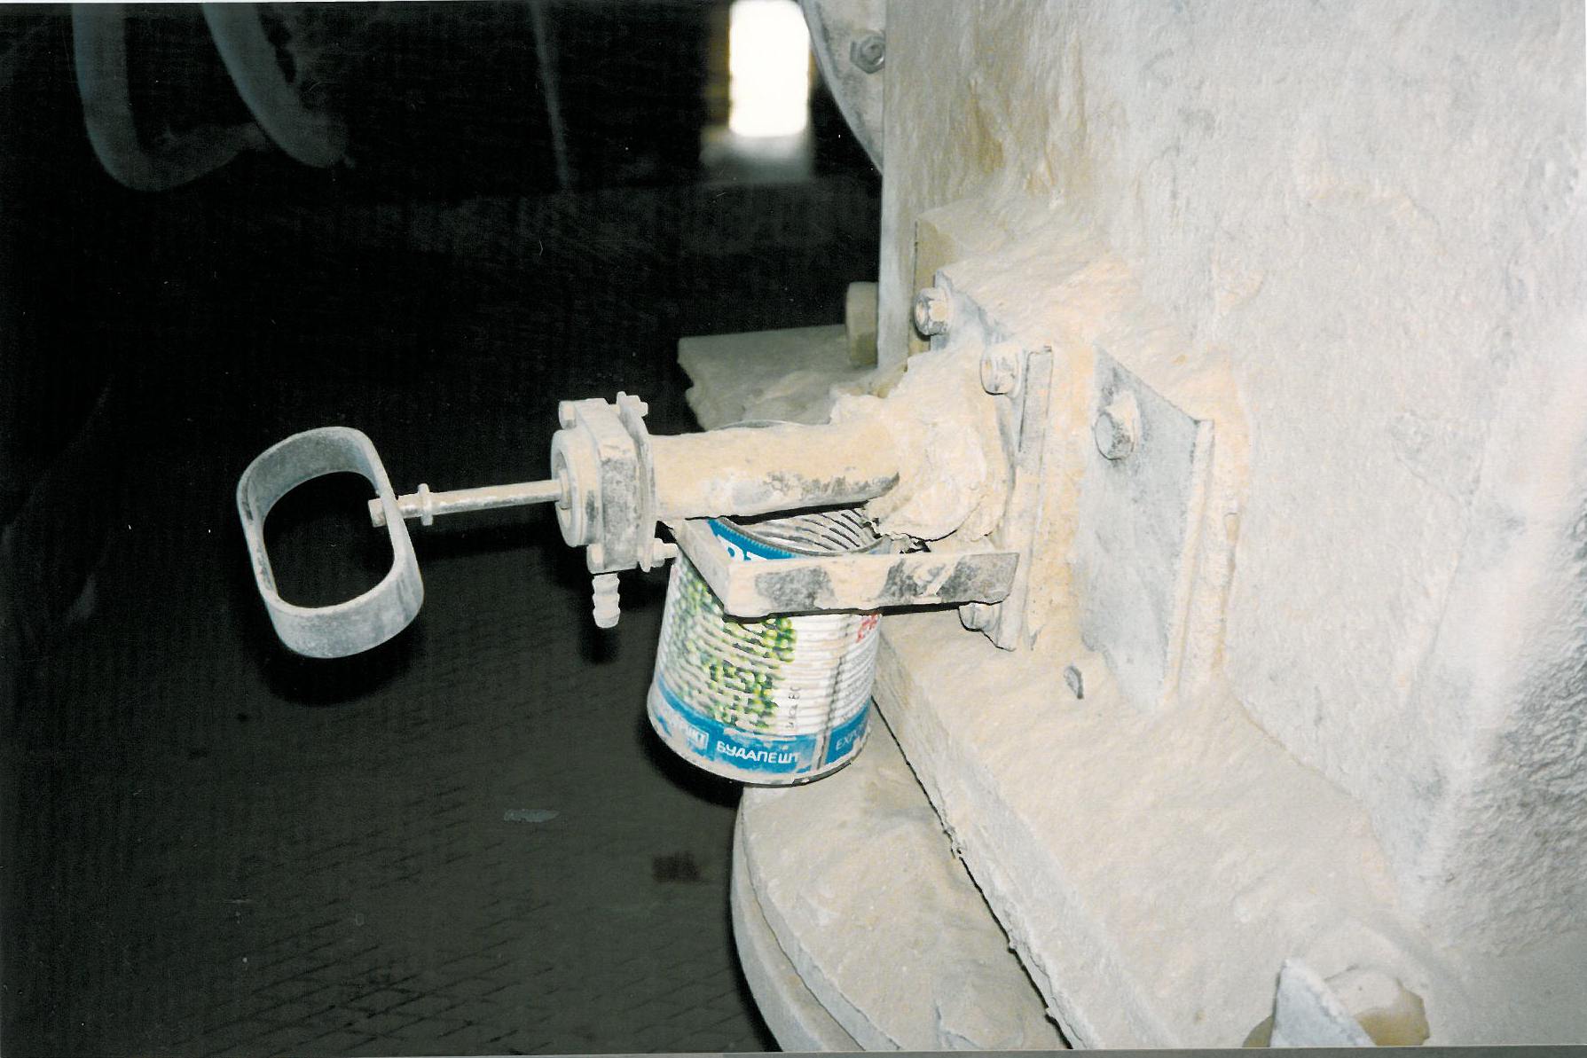
Powder sampling: suggest improvements …
46

Slide 47
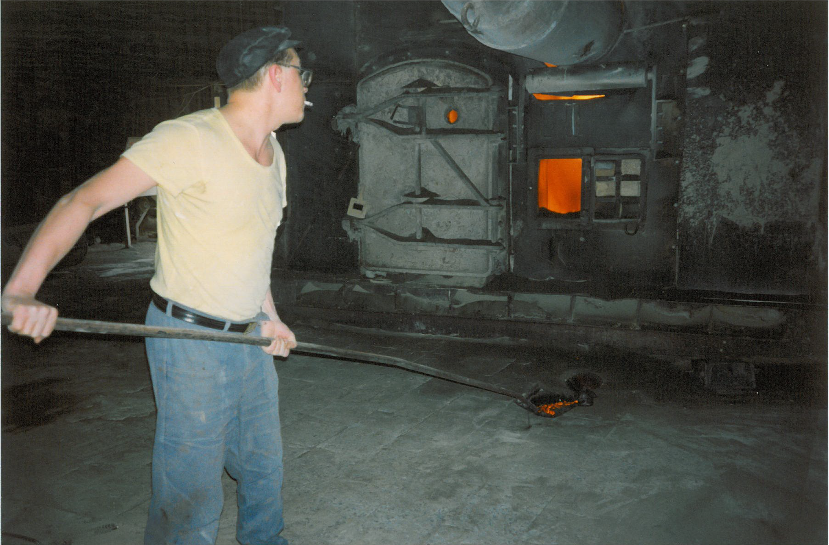
Clinker sampling: Not recommended
47

